Slide 1


Are You Smarter
Than a 5th Grader?
Debridement Version
Questions created by:
The South West Regional Wound Care Program

Slide 2
Are You Smarter Than a
5th Grader?
1,000,000
500,000
300,000
5th Grade Topic 1
5th Grade Topic 2
175,000
100,000
4th Grade Topic 3
4th Grade Topic 4
50,000
25,000
3rd Grade Topic 5
3rd Grade Topic 6
10,000
2nd Grade Topic 7
2nd Grade Topic 8
5,000
2,000
1st Grade Topic 9
1st Grade Topic 10
1,000

Slide 3
5th Grade Topic 1 Question
This type of necrotic tissue is often hard, black/brown, and firmly attached to the wound bed

Slide 4
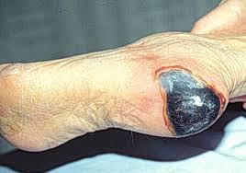
5th Grade Topic 1 Answer
Eschar
Return

Slide 5
5th Grade Topic 2 Question
Name ONE reason we debride wounds

Slide 6
5th Grade Topic 2 Answer
To reduce bacterial burden
To convert a chronic wound into an acute wound
To facilitate earlier coverage of the wound with active dressings or biologicals
To remove debris to allow for granulation, contraction, and epithelialization
Return

Slide 7
4th Grade Topic 3 Question
This type of necrotic tissue is often soft/soggy/stringy, yellow/tan, and can either be firmly or loosely attached

Slide 8
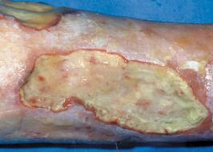
4th Grade Topic 3 Answer
Slough
Return

Slide 9
4th Grade Topic 4 Question
Name the five types of debridement

Slide 10
4th Grade Topic 4 Answer
Sharp
Enzymatic
Autolytic
Biologic
Mechanical
Return

Slide 11
3rd Grade Topic 5 Question
What is the main difference between surgical sharp debridement and conservative sharp debridement?

Slide 12
3rd Grade Topic 5 Answer
Surgical sharp debridement is the removal of viable and non-viable tissue, while conservative sharp debridement is the removal of non-viable tissues only
Return

Slide 13
3rd Grade Topic 6 Question
This form of necrotic tissue is often hard, black/brown, firmly attached, and associated with arterial/ischemic wounds

Slide 14
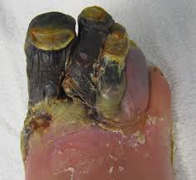
3rd Grade Topic 6 Answer
Gangrene
Return

Slide 15
2nd Grade Topic 7 Question
This type of debridement is done using commercially prepared proteolytic enzymes to degrade necrosis by digesting devitalized tissues

Slide 16
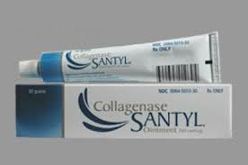
2nd Grade Topic 7 Answer
Enzymatic debridement
Return

Slide 17
2nd Grade Topic 8 Question
Non-healable wounds should only have this type of tissue removed, viable or non-viable?

Slide 18
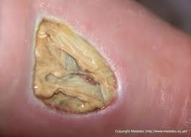
2nd Grade Topic 8 Answer
Non-viable
Return

Slide 19
1st Grade Topic 9 Question
This type of debridement uses the body’s own enzymes to remove non-viable tissue

Slide 20
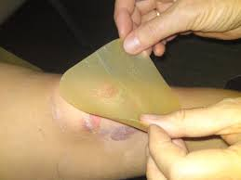
1st Grade Topic 9 Answer
Autolytic debridement
Return

Slide 21
1st Grade Topic 10 Question
This is the most commonly used debridement technique, despite it’s multiple disadvantages

Slide 22
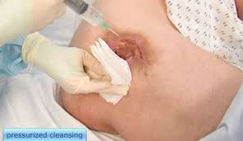
1st Grade Topic 10 Answer
Mechanical Debridement
Return

Slide 23
Million Dollar Question
Grade Level Topic 11
This health care professional, if they meet certain conditions, can initiate debridement

Slide 24

1,000,000 Answer
An RN or an RN(EC)

Slide 25
Thanks for Playing!
For more information visit the SWRWCP at www.swrwoundcareprogram.ca

