Slide 1

Questions Created by:
The South West Regional Wound Care Program
LET’S PLAY ….
WOUND ASSESSMENT AND MEASUREMENT
JEOPARDY
Note: All photos obtained from Google Images

Slide 2

Jeopardy
Wound Assessment
Wound Measurement
Wound Edge & Exudate
Necrotic Tissue
Granulation & Epithelialization
Q $100
Q $100
Q $100
Q $100
Q $100
Q $200
Q $200
Q $200
Q $200
Q $200
Q $300
Q $300
Q $300
Q $300
Q $300
Q $400
Q $400
Q $400
Q $400
Q $400
Q $500
Q $500
Q $500
Q $500
Q $500
Final Jeopardy

Slide 3

$100 Question from Category 1
  These are the instruments or means the wound/wound characteristics are measured/assessed

Slide 4

$100 Answer from Category 1
Tests

Slide 5
$200 Question from Category 1
  This is the process of making clinical judgments based on the data obtained from an exam

Slide 6

$200 Answer from Category 1
Evaluation

Slide 7
$300 Question from Category 1
These list the wound characteristics that will be tracked over the course of care

Slide 8
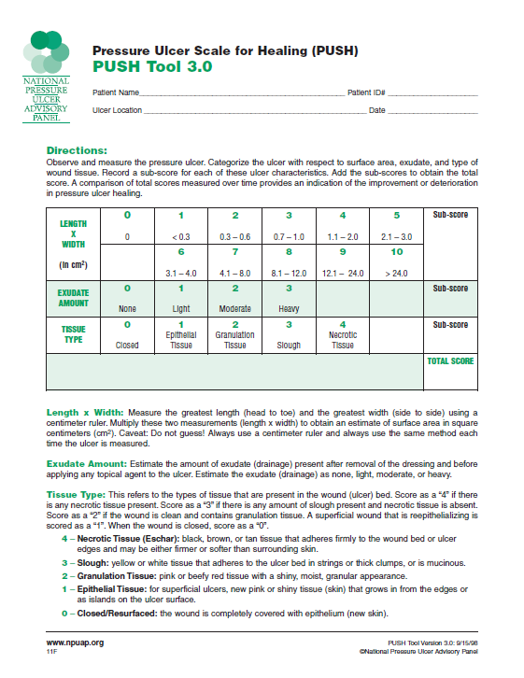
$300 Answer from Category 1
Standardized data collection/documentation forms

Slide 9
$400 Question from Category 1
This is an example of a valid, reliable wound healing tool

Slide 10
$400 Answer from Category 1
  Pressure Ulcer Scale for Healing (PUSH)
  Bates-Jensen Wound Assessment Tool (BWAT)
  Photographic Wound Assessment Tool (PWAT)

Slide 11
$500 Question from Category 1
True or False
Depending on the person’s medical diagnosis and/or medical impairments, multiple assessment forms may be required

Slide 12
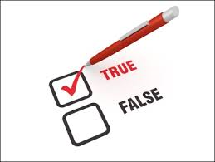
$500 Answer from Category 1
True

Slide 13
$100 Question from Category 2
The three components of wound size measurements are:
Area
Depth
________________

Slide 14
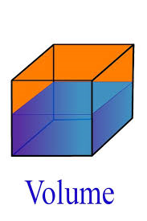
$100 Answer from Category 2
    Volume

Slide 15
$200 Question from Category 2
    This is one tip to measure wounds more accurately

Slide 16
$200 Answer from Category 2
Define specific procedures to determine:
  Wound edge
  Total wound area
Take measurements the same way each time from noted reference point on the body
Use same units of measure and terminology for each measurement
Have same person take measurements
Use an assistant to record measurements
Use a prepared form

Slide 17
$300 Question from Category 2
True or False
To determine the surface area of a wound you multiply the longest length x the widest perpendicular width

Slide 18
$300 Answer from Category 2
True

Slide 19
$400 Question from Category 2
This term refers to the practice of tracing of a wound shape on metric graph paper

Slide 20
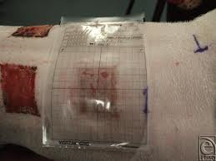
$400 Answer from Category 2
Planimetry

Slide 21
$500 Question from Category 2
What is one tip for taking a good wound photo?

Slide 22
$500 Answer from Category 2
Use a good lighting source
Screen private areas from the camera
Position the ruler to show relative size
Use a string of known length and position camera from wound the same distance every time
Use id signs with pt. id, wound location, and date
Use a ring flash attachment to reduce shadows
Use an assistant to position the person and id sign

Slide 23
$100 Question from Category 3
DOUBLE JEOPARDY
  Wound edges that are even or flush with the wound base, with no sides or walls present, flat are called this

Slide 24
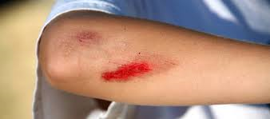
$100 Answer from Category 3
Attached

Slide 25
$200 Question from Category 3
  This is the term for the callus like tissue formation around a wound edge

Slide 26
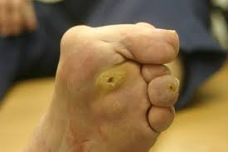
$200 Answer from Category 3
Hyperkeratosis

Slide 27
$300 Question from Category 3
This is the term for separation of the fascial planes that leads to a sinus tract

Slide 28
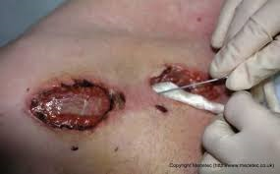
$300 Answer from Category 3
Tunnel

Slide 29
$400 Question from Category 3
This is the term for an erosion under the edge of a wound

Slide 30
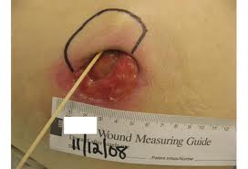
$400 Answer from Category 3
Undermining

Slide 31
$500 Question from Category 3
  This type of exudate is clear, contains no debris, blood or pus, and is generally odorless

Slide 32
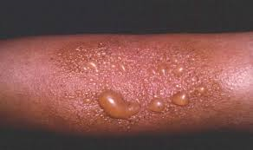
$500 Answer from Category 3
Serous

Slide 33
$100 Question from Category 4
Necrotic tissue can be white/grey, yellow, brown or this color

Slide 34
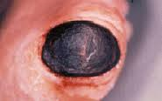
$100 Answer from Category 4
Black

Slide 35
$200 Question from Category4
Necrotic tissue that is strongly attached to tissue in wound base and to wound edges is called this

Slide 36
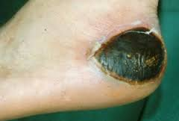
$200 Answer from Category 4
Firmly adherent

Slide 37
$300 Question from Category 4
There are two primary types of necrotic tissue, slough and this

Slide 38
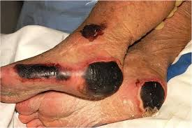
$300 Answer from Category 4
Eschar

Slide 39
$400 Question from Category 4
  This type of necrotic tissue typically indicates deeper tissue damage

Slide 40
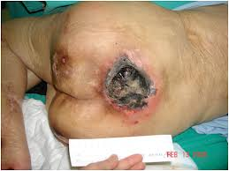
$400 Answer from Category 4
Eschar

Slide 41
$500 Question from Category 4
Necrotic tissue that is easily separated from wound tissue is called this

Slide 42
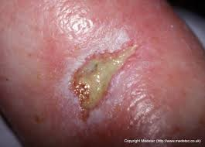
$500 Answer from Category 4
Non-adherent

Slide 43
$100 Question from Category 5
This is the growth of small blood vessels and connective tissue into the wound cavity

Slide 44
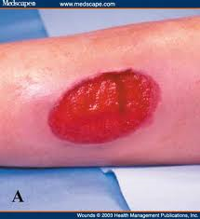
$100 Answer from Category 5
Granulation tissue

Slide 45
$200 Question from Category 5
This is a building up of tissue that prevents epidermal migration or resurfacing across the wound, by proliferating above the intact margins of the skin

Slide 46
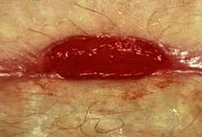
$200 Answer from Category 5
Hypergranulation tissue

Slide 47
$300 Question from Category 5
This type of tissue may migrate from islands on the wound surface, the wound edges, or both

Slide 48
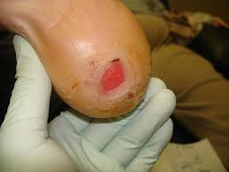
$300 Answer from Category 5
Epithelial tissue

Slide 49
$400 Question from Category 5
Granulation tissue is healthy when it is this color

Slide 50
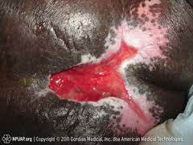
$400 Answer from Category 5
Bright red

Slide 51
$500 Question from Category 5
Hypergranulation may indicate this at the wound surface

Slide 52
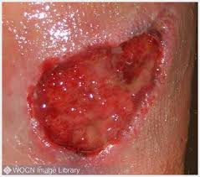
$500 Answer from Category 5
Excessive moisture or increased bacterial burden

Slide 53
Final Jeopardy
What is the % reduction in the wound surface area of a wound with an initial wound surface area of 10cm² and a surface are of 5cm² at one month?

Slide 54

Final Jeopardy Answer
50%

